Slide 1
Types of Research

Slide 2
Basic Types Of Research

Slide 3
Descriptive vs. Analytical

Slide 4
Descriptive research
Includes surveys and fact-finding enquiries of different kinds.
The major purpose of descriptive research is description of the state of affairs as it exists at present.
In social science and business research it is also called - Ex post facto research.
The main characteristic of this method –the researcher has no control over the variables; he can only report what has happened or what is happening.
Mostly used for descriptive studies in which the researcher seeks to measure items
Example- frequency of shopping, preferences of people, or similar data.
Also include attempts by researchers to discover causes even when they cannot control the variables.
The methods of research utilized in descriptive research are survey methods of all kinds, including comparative and correlational methods.
Notes:
A variable is a quantity of something which varies and you are interested in.
Example - Price of gasoline is a variable to an economic analyst studying the recent gasoline price increase but not to most motorists and not even to an economic analyst studying the relation between stock and bond prices.

Slide 5
Analytical Research
The researcher has to use facts or information already available, and analyze these to make a critical evaluation of the material.
It is a critical evaluation based on information that is available and primarily concerned with testing hypothesis; specifying and interpreting relationships by analyze the facts or existing information.
Example : Starting from late 1986, the value of U.S. dollar value has steadily increased against the Japanese yen and German Mark. Examining the magnitude of this trend in the value of U.S. dollar is another example of descriptive research; while explaining how and why this surge in the value of the U.S. dollar is occurring.
If one attempts to explain how and why this surge in the value of U.S. dollar is going to affect the U.S. economy, as well as the economies of Japan and Germany, this is another example of analytical research.

Slide 6
Applied vs. Fundamental

Slide 7
Applied research
It aims at finding a solution for an immediate problem facing a society or an industrial/business organisation.
The central aim of applied research is to discover a solution for some pressing practical problem.
Example –
Research aimed at certain conclusions (say, a solution) facing a concrete social or business problem.
Research to identify social, economic or political trends that may affect a particular institution.
The copy research (research to find out whether certain communications will be read and understood)
The marketing research
Evaluation research

Slide 8
Fundamental research
Also called basic or pure research.
It is mainly concerned with generalisations and with the formulation of a theory.
“Gathering knowledge for knowledge’s sake is termed ‘pure’ or ‘basic’ research.”
The central aim of Fundamental research is finding information that has a broad base of applications and thus, adds to the already existing organized body of scientific knowledge.
Examples –
Research concerning some natural phenomenon or relating to pure mathematics.
Research studies, concerning human behaviour carried on with a view to make generalisations about human behaviour.

Slide 9
Quantitative vs. Qualitative

Slide 10
Quantitative research
Quantitative research is based on the measurement of quantity or amount.
It is applicable to phenomena that can be expressed in terms of quantity.
Quantitative research is statistical: it has numbers attached to it, like averages, percentages or quotas.
Example - You might perform a study and find that 50% of a district’s students dislike their teachers. The quantity (50%) makes it quantitative research. A follow up qualitative study could interview a small percentage of those students to find out why.

Slide 11
Qualitative research
Qualitative research, on the other hand, is concerned with qualitative phenomenon, i.e., phenomena relating to or involving quality or kind.
Investigating the reasons for human behaviour (i.e., why people think or do certain things) - ‘Motivation Research’, an important type of qualitative research.
This type of research aims at discovering the underlying motives and desires, using in depth interviews for the purpose.
Techniques used - projective techniques :
word association tests
in depth interviews
sentence completion tests
story completion tests

Slide 12
Qualitative research
Attitude or opinion research i.e., research designed to find out how people feel or what they think about a particular subject or institution is also qualitative research.
Qualitative research is specially important in the behavioral sciences where the aim is to discover the underlying motives of human behavior.
Through such research we can analyse the various factors which motivate people to behave in a particular manner or which make people like or dislike a particular thing.
To apply qualitative research in practice is relatively a difficult job and therefore, while doing such research, one should seek guidance from experimental psychologists.

Slide 13
Conceptual vs. Empirical

Slide 14

Conceptual research
Conceptual research is that related to some abstract idea(s) or theory.
It is generally used by philosophers and thinkers to develop new concepts or to reinterpret existing ones.
Conceptual research focuses on the concept or theory that explains or describes the phenomenon being studied. What causes disease? How can we describe the motions of the planets? What are the building blocks of matter?
The conceptual researcher sits at his desk with pen in hand and tries to solve these problems by thinking about them.
He does no experiments but may make use of observations by others, since this is the mass of data that he is trying to make sense of.
Until fairly recently, conceptual research was considered the most honorable form of research—it required using the brain, not the hands.

Slide 15
Empirical research
Empirical research relies on experience or observation alone, often without due regard for system and theory.
It is data-based research, coming up with conclusions which are capable of being verified by observation or experiment.
Also called Experimental research.
It is necessary to get at facts firsthand, at their source, and actively to go about doing certain things to stimulate the production of desired information.

Slide 16

Empirical research
Steps:
Researcher must first provide himself with a working hypothesis or guess as to the probable results.
He then works to get enough facts (data) to prove or disprove his hypothesis.
He then sets up experimental designs which he thinks will manipulate the persons or the materials concerned so as to bring forth the desired information.
Such research is thus characterized by the experimenter’s control over the variables under study and his deliberate manipulation of one of them to study its effects.
Appropriate when proof is sought that certain variables affect other variables in some way.
Evidence gathered through experiments or empirical studies is today considered to be the most powerful support possible for a given hypothesis.

Slide 17
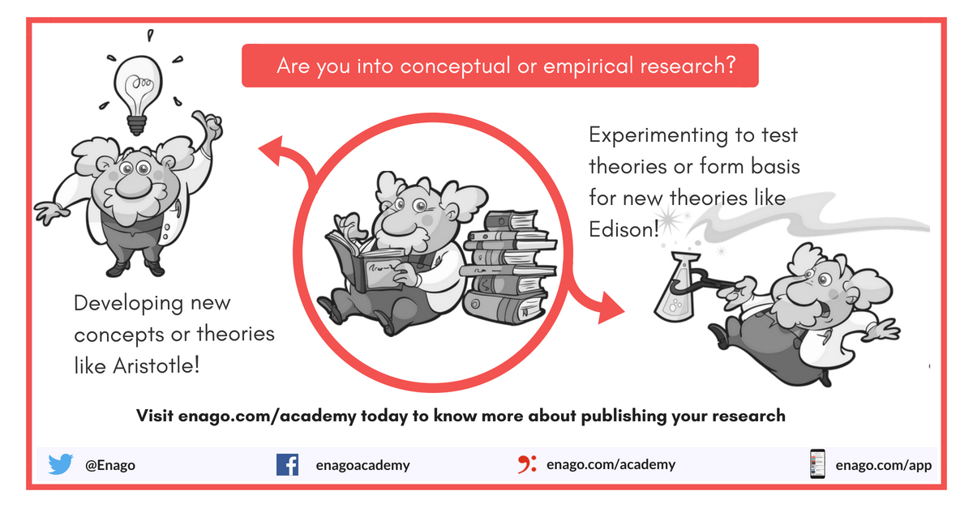

Slide 18
Other types of research

Slide 19
One-time research - the research is confined to a single time-period.
Longitudinal research - the research is carried on over several time-periods.
Research can be field-setting research or laboratory research or simulation research, depending upon the environment in which it is to be carried out.
Research can as well be understood as clinical or diagnostic research.
Such research follow case-study methods or indepth approaches to reach the basic causal relations. Such studies usually go deep into the causes of things or events that interest us, using very small samples and very deep probing data gathering devices.

Slide 20
Exploratory research - The objective is the development of hypotheses rather than their testing.
Exploratory research is defined as a research used to investigate a problem which is not clearly defined.
It is conducted to have a better understanding of the existing problem, but will not provide conclusive results.
For such a research, a researcher starts with a general idea and uses this research as a medium to identify issues, that can be the focus for future research.
An important aspect here is that the researcher should be willing to change his/her direction, subject to the revelation of new data or insight.
Such a research is usually carried out when the problem is at a preliminary stage.
It is often referred to as grounded theory approach or interpretive research as it used to answer questions like what, why and how.
Eg: Customers buying a phone
Notes:
An hypothesis is a specific statement of prediction.
It describes in concrete (rather than theoretical) terms what you expect will happen in your study.

Slide 21
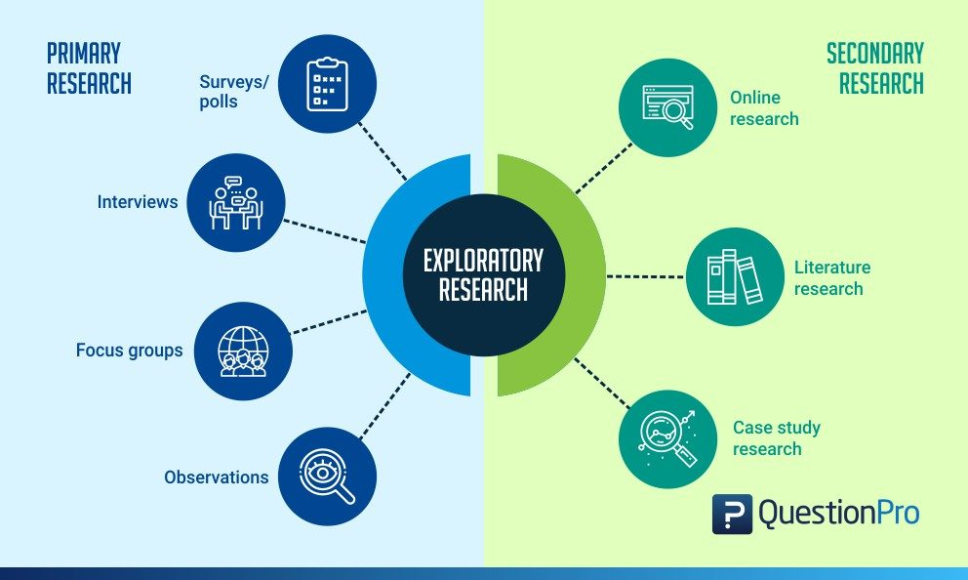
Exploratory research

Slide 22
Formalized research - those with substantial structure and with specific hypotheses to be tested.
Historical research is that which utilizes historical sources like documents, remains, etc. to study events or ideas of the past, including the philosophy of persons and groups at any remote point of time.
Conclusion-oriented research -a researcher is free to pick up a problem, redesign the enquiry as he proceeds and is prepared to conceptualize as he wishes.
Decision-oriented research - always for the need of a decision maker and the researcher in this case is not free to embark upon research according to his own inclination.
Example - Operations research- it is a scientific method of providing executive departments with a quantitative basis for decisions regarding operations under their control.
Notes:
An hypothesis is a specific statement of prediction.
It describes in concrete (rather than theoretical) terms what you expect will happen in your study.

